Slide 1

Steam API for game recommendation

Slide 2
Team Members
Zijian Chen
Xueming Feng
Lu Liu
Chengjun Wu
Zhongmin Yao
Honghao Zeng

Slide 3
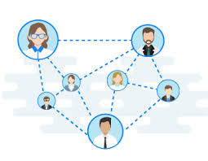

Why this is a good idea?
Organize user information
Expand social network
Bring friend and game recommendation
Improve user gaming experience

Slide 4
Main language and tool
HTML
JavaScript
CSS
VIS.js
Graph.js
Language
Tool

Slide 5
Main function
Analyze user’s gaming time
Analyze user’s gaming category
Analyze user’s social network
Friend recommendation
Game suggestion
Create chart

Slide 6
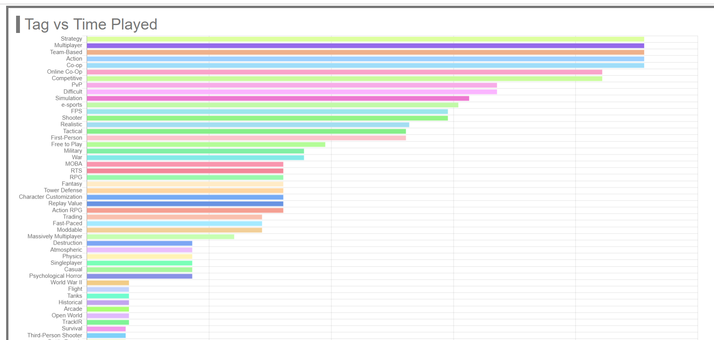
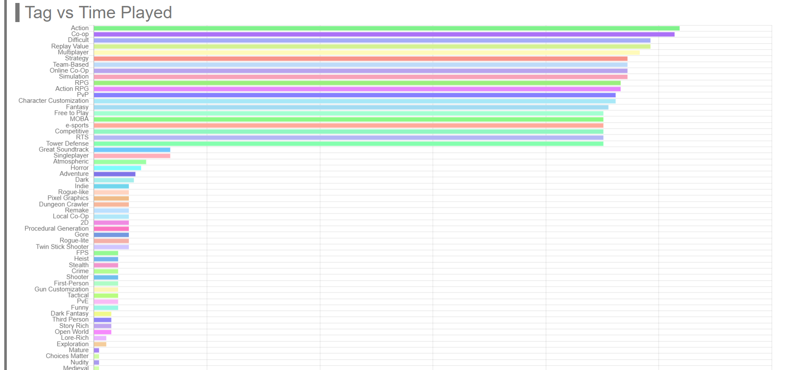
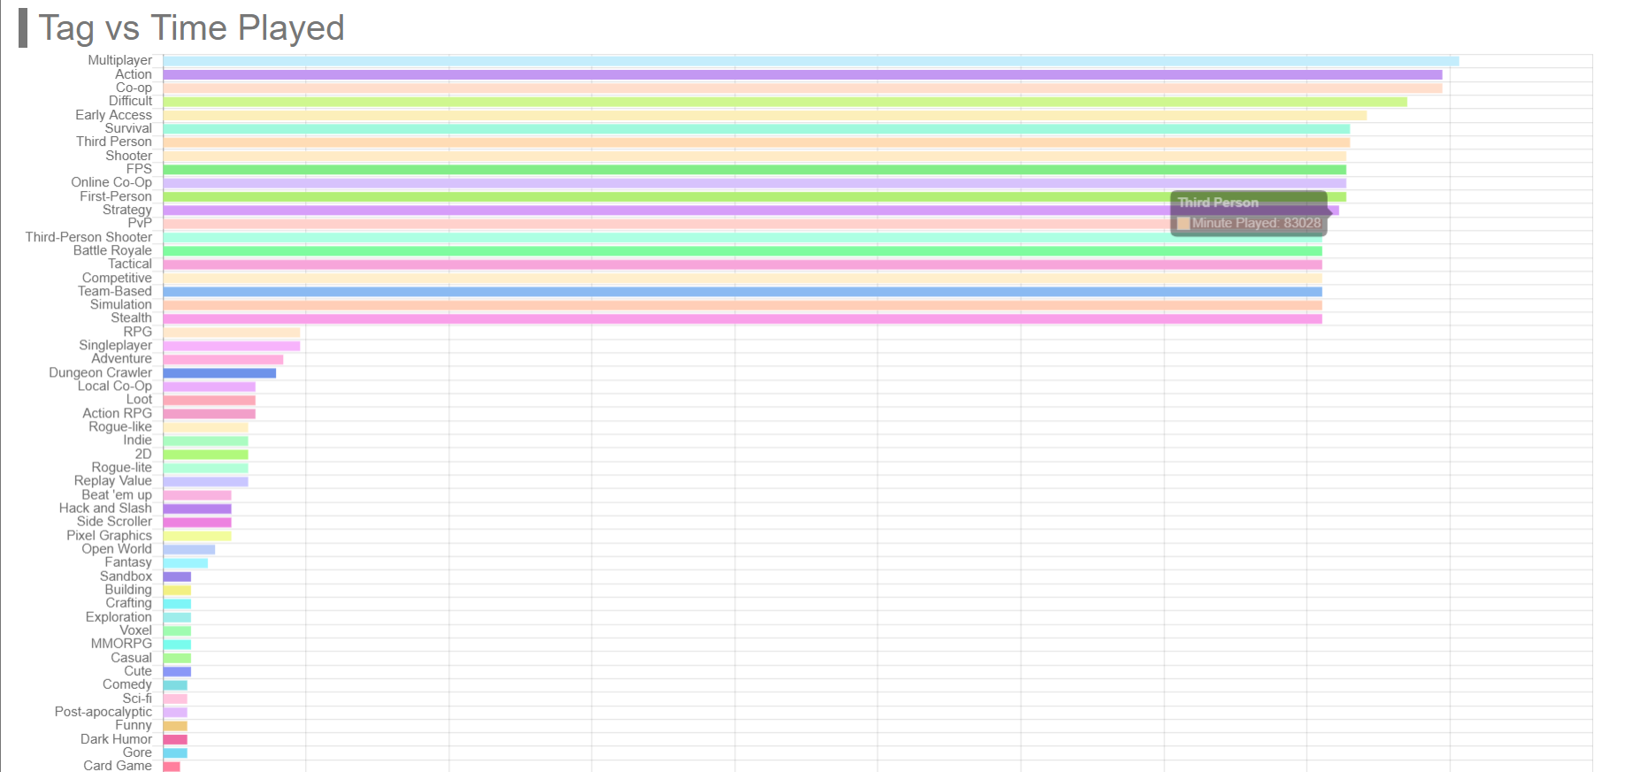
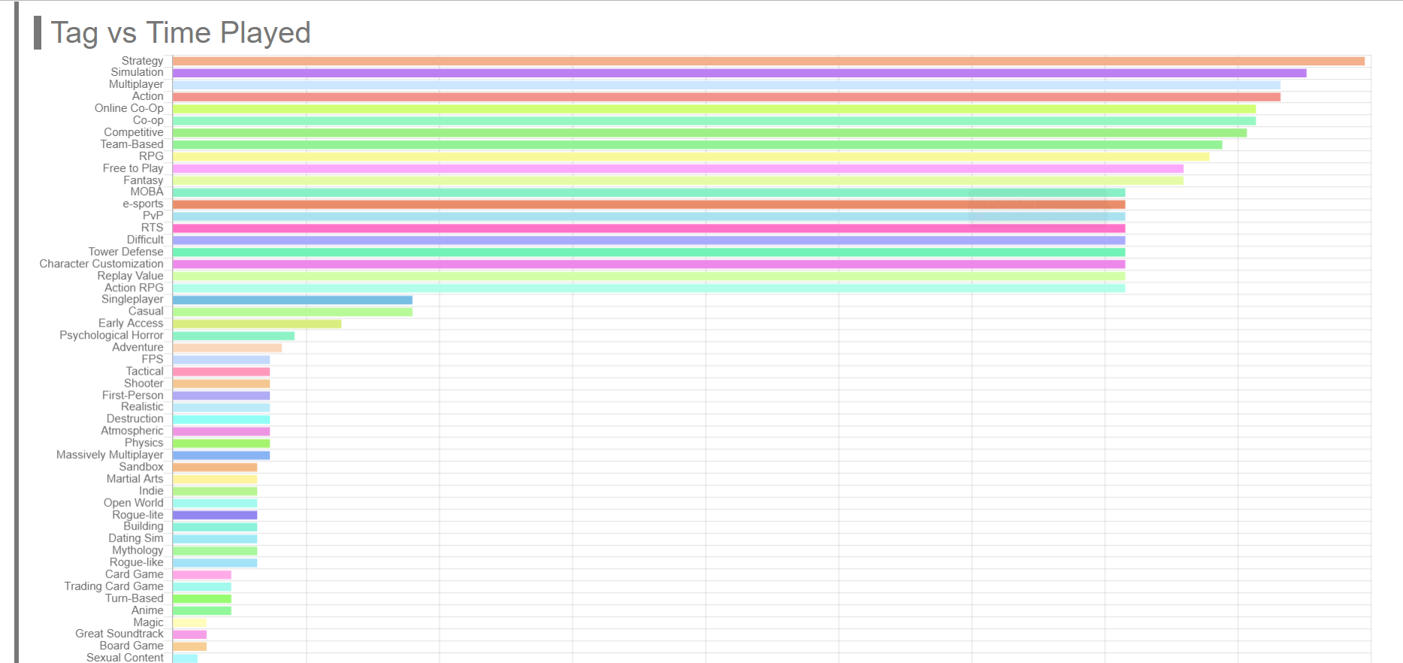
Example of gaming category analyze
User ID: gongyichun
User ID: steven
User ID: stan
User ID:sbwwq

Slide 7
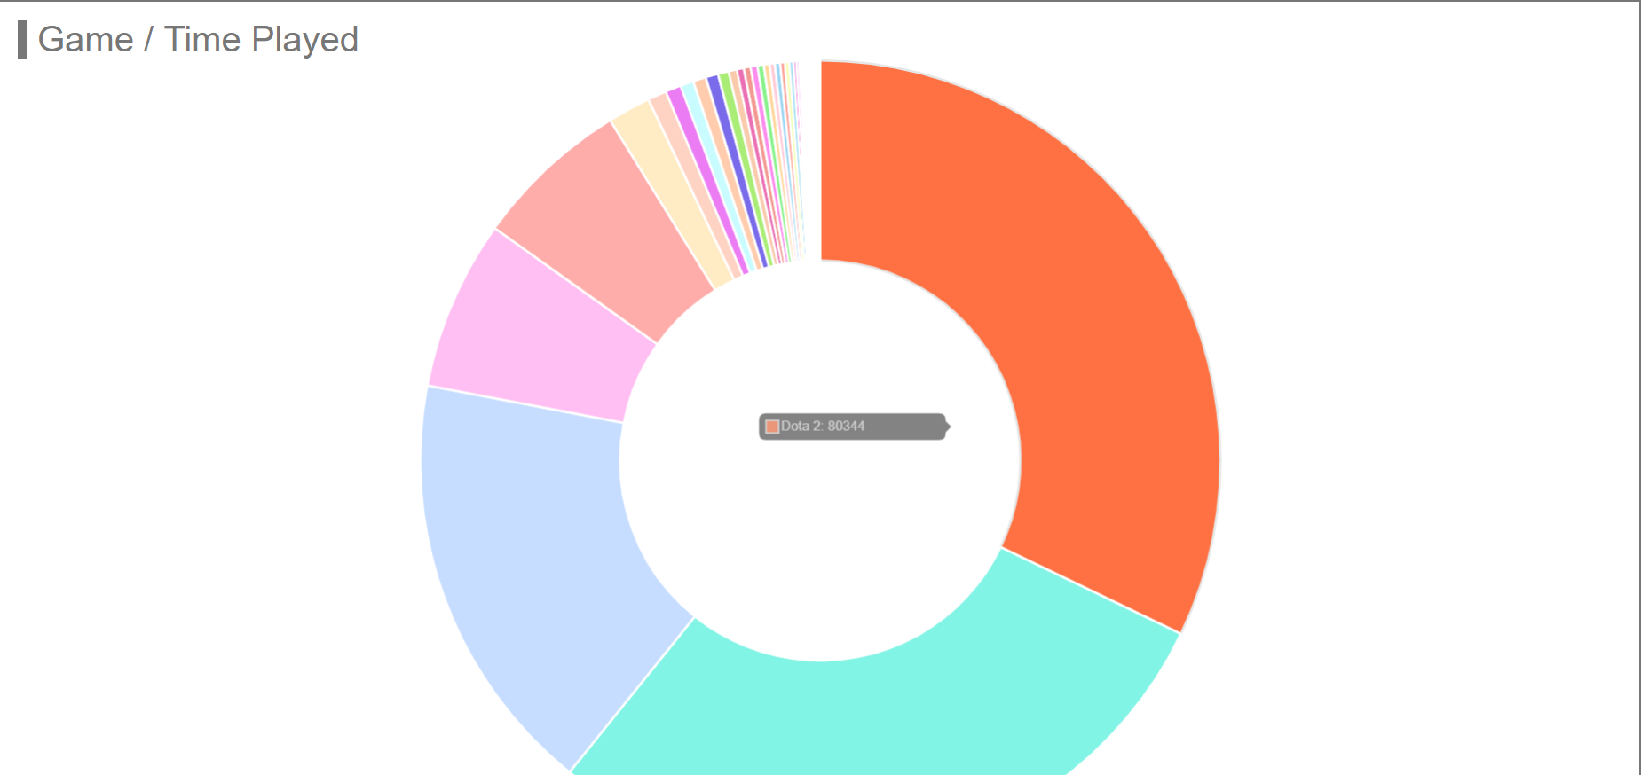
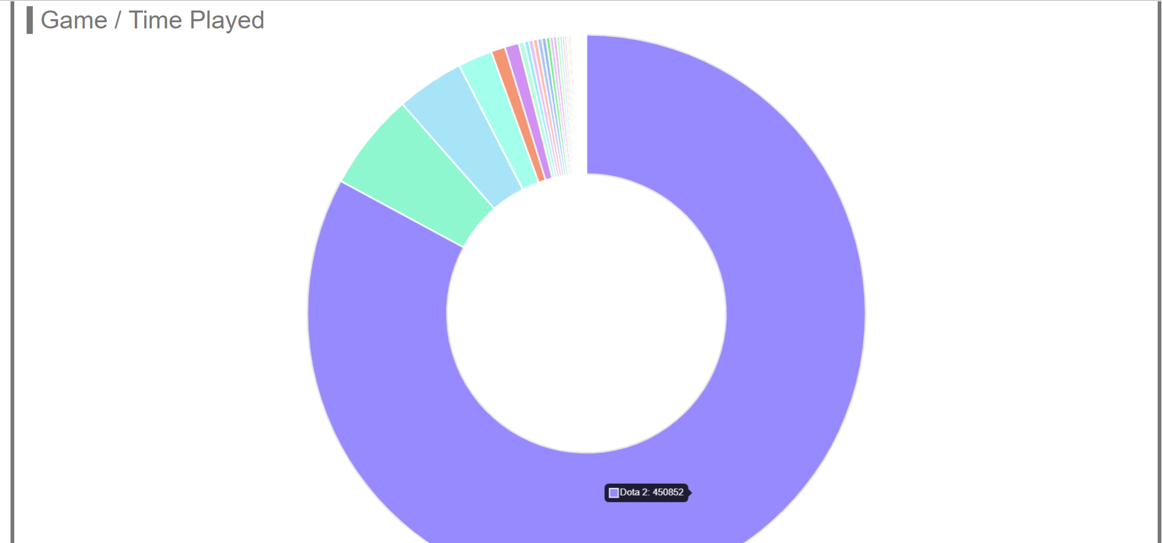
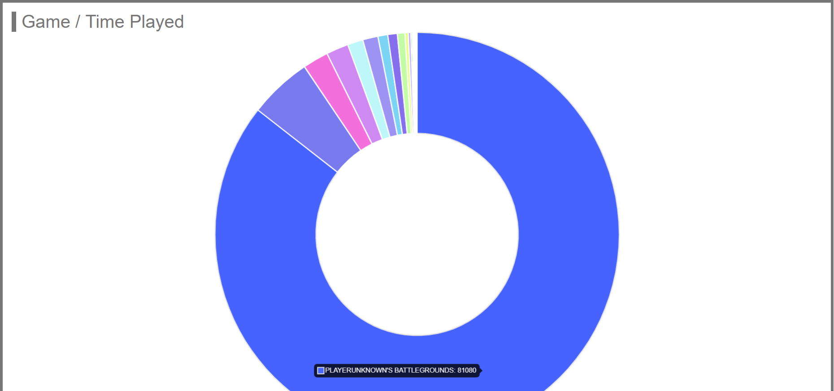
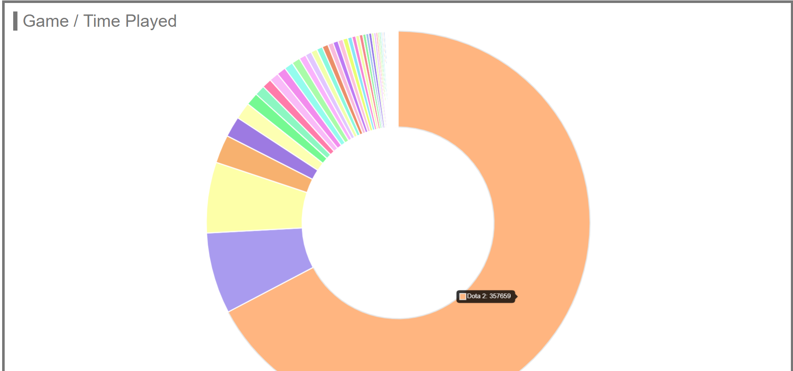
Example of gaming time analyze
User ID: gongyichun
User ID: steven
User ID: stan
User ID:sbwwq

Slide 8
Website links
Navigation page: http://ny.kuroa.me/index.html
Time and Category page: http://ny.kuroa.me/user-tags-graph.html
Game page: http://ny.kuroa.me/stan.html
Game Suggestion page: http://ny.kuroa.me/suggestion.html
Friend Recommendation page: http://ny.kuroa.me/friends_recommend.html

Slide 9
Thank You

